Slide 1

Test Driven Development with Blazor
Slides up at scottsauber.com
scottsauber

Slide 2

Audience
Familiar with Blazor
Interested in learning TDD
scottsauber

Slide 3
Agenda
What is TDD?
Why TDD?
Tools you can use
What do I test?
Live Demos
scottsauber

Slide 4
Goals
Learn “best practices*” for writing frontend tests
Share with .NET community testing learnings from React community
Learn how to TDD (with Blazor!)
* Synonym for “Just My Opinions” and I’ll probably find a way I like better in the future
scottsauber

Slide 5





Who am I?
Director of Engineering at Lean TECHniques
Microsoft MVP
Dometrain Author
Redgate Community Ambassador
Co-organizer of Iowa .NET User Group
Used Blazor, Angular, or React since 2015

Slide 6
Why do we write tests?
We want confidence our application works
Minimize manual verification
Document behavior through tests
scottsauber

Slide 7

What is TDD?
scottsauber

Slide 8
What is TDD?
Methodology for writing code (not just tests)
You write the test BEFORE you write the production code
scottsauber

Slide 9
How to TDD?
Think
Write a test that describes the behavior you want to see
Run the test and watch it fail for the right reason
Write code to make it pass
Refactor
Repeat
scottsauber

Slide 10
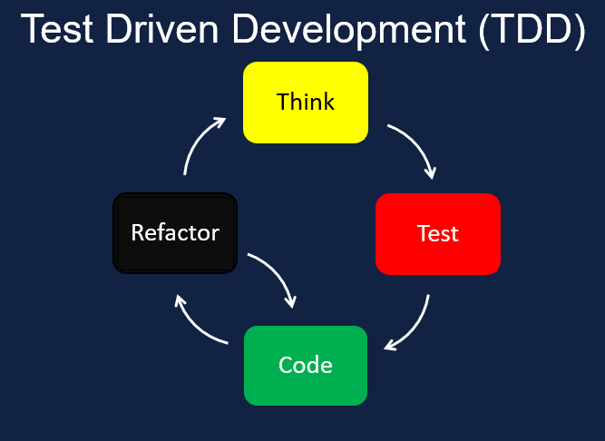
How to TDD?

Slide 11

“If you haven’t seen a test fail, you don’t know if it works.”
Eric Evans

Slide 12
Why Test Driven Development?
Work in small steps (minimizes waste, minimizes WIP)
Focus
Much less time in the debugger
Thinking through failure states
Confidence
Design feedback, hard to write test? Design might be wrong
Oh yeah… regression tests are nice too
scottsauber

Slide 13
What is NOT TDD?
TDD is NOT a synonym for writing tests
TDD is NOT writing multiple tests up front before writing any production code
TDD does NOT mean no bugs ever (just less)
TDD is not good for adding tests to existing production code
TDD zealots do more harm than good
scottsauber

Slide 14

Applying TDD to Blazor

Slide 15
Introduction to Tools
xUnit
Shouldly
bUnit
scottsauber

Slide 16
xUnit
Test framework
Used by Microsoft to test .NET
scottsauber

Slide 17
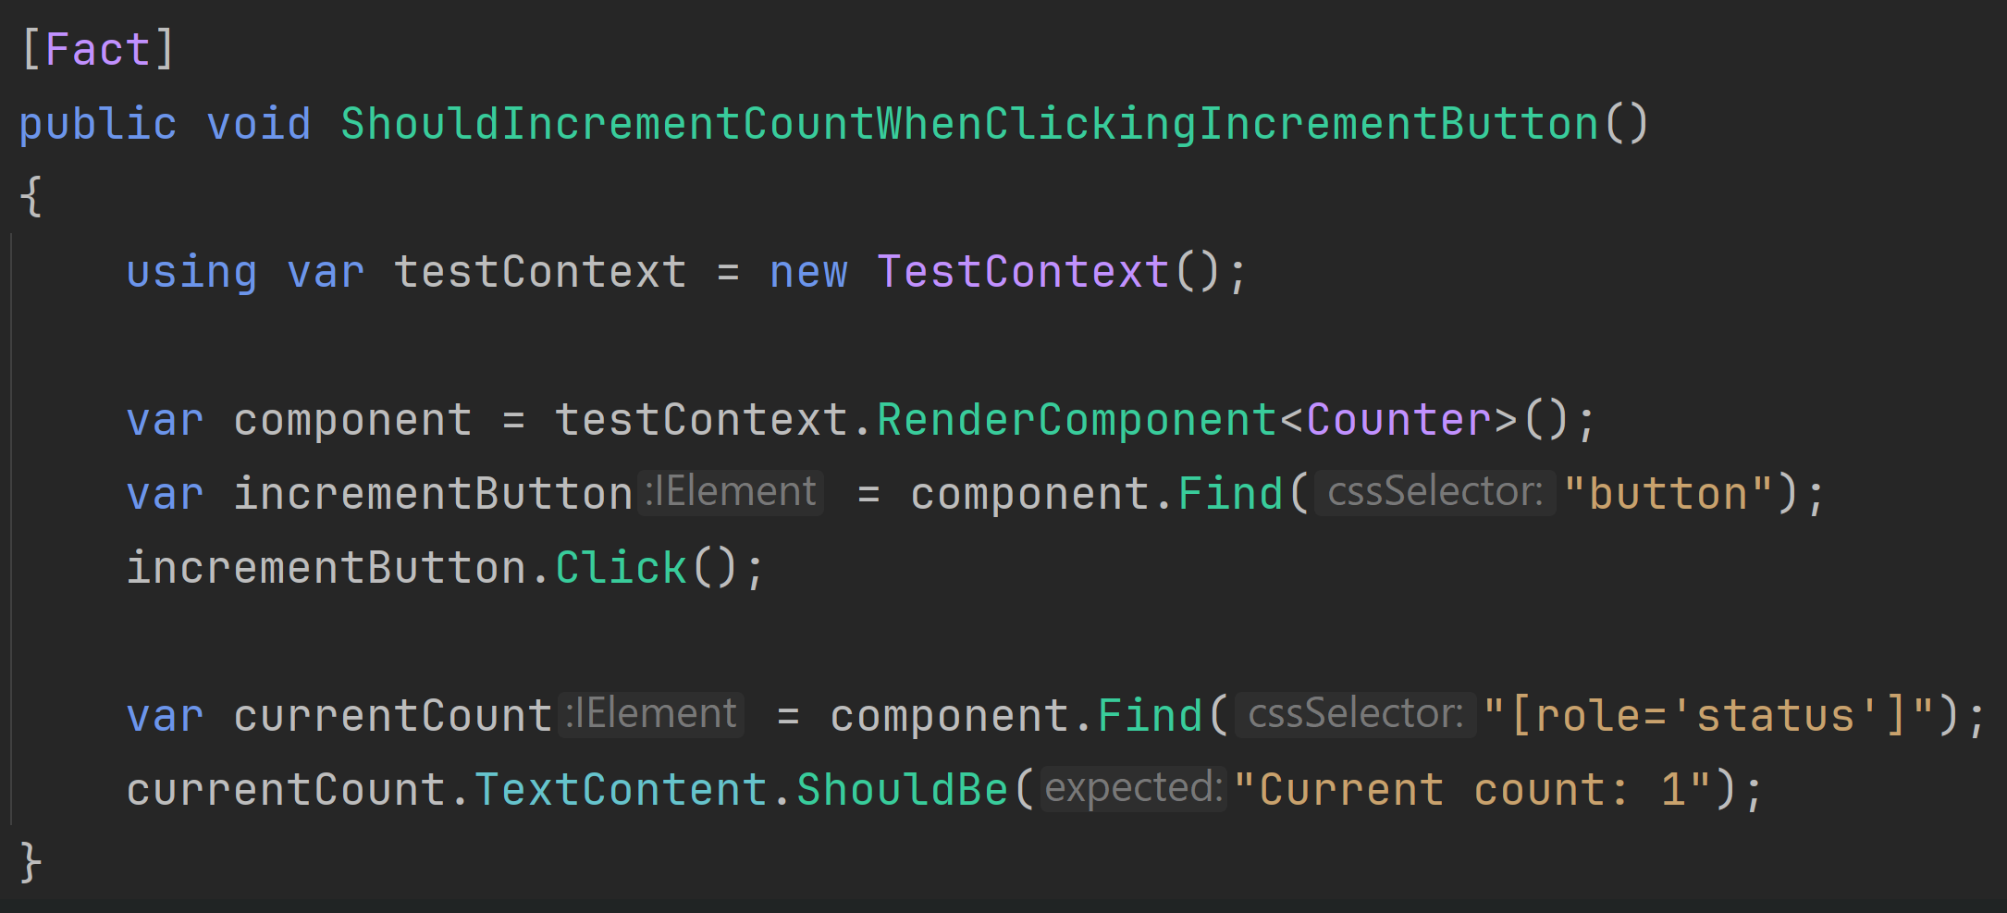
xUnit
scottsauber

Slide 18
Shouldly
Assertion library
~80M downloads on NuGet
Cleaner assertions
scottsauber

Slide 19
Shouldly
scottsauber

Slide 20
bUnit
Helper library for testing Blazor
Renders components
Queries for the DOM
Inject fake dependencies
Fakes for various things (i.e. NavigationManager)
scottsauber

Slide 21
bUnit
scottsauber

Slide 22
What should I test?
Behavior
Not that CSS classes exist or any other attributes directly exist
You can’t prove your app looks good with tests
Behavior
If I can delete code that breaks your app, but your tests don’t – that’s a problem
If my tests break but my application isn’t broken - that’s a problem
Flaky Test?
Implementation detail?
scottsauber

Slide 23
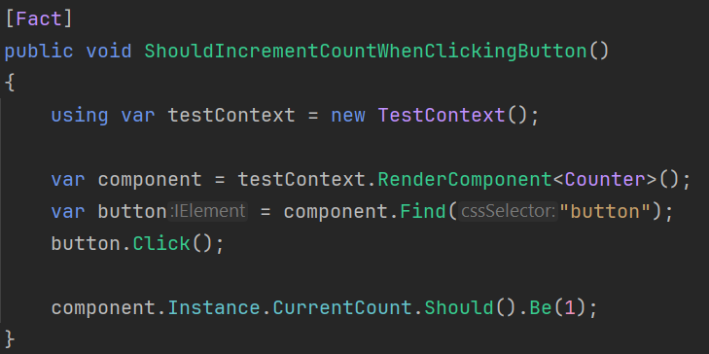
❌ Current Count is an implementation detail, not behavior
scottsauber

Slide 24
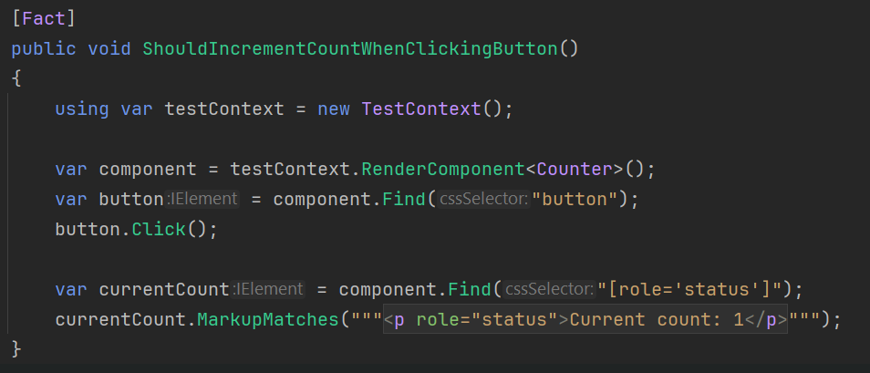
❌ The HTML is an implementation detail, not behavior
scottsauber

Slide 25
✅ This is the behavior you care about!
scottsauber

Slide 26
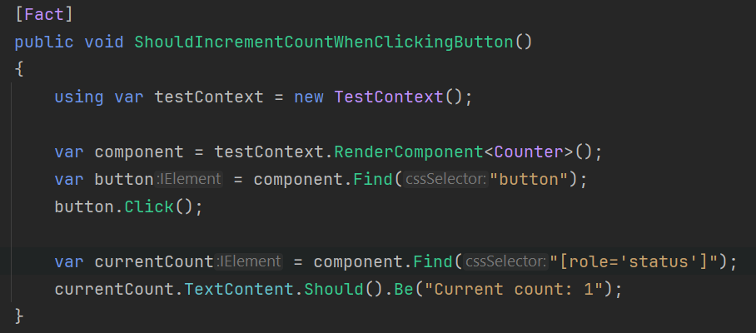
❌
❌
✅
scottsauber

Slide 27

“The more your tests resemble the way your software is used the more confidence they can give you.”
Kent C Dodds
react-testing-library creator

Slide 28
What should I NOT test?
You can’t test if your app looks good – so don’t test CSS
Do NOT test implementation details
Avoid using MarkupMatches for applications
Too many implementation details (i.e. classes, DOM nodes, etc.)
Avoid using .Instance for applications
Too many implementation details (i.e. Property, Methods, etc.)
scottsauber

Slide 29
Avoid snapshot tests (like Verify)
Avoid using snapshots for your Blazor components… (mostly)
Snapshots don’t capture desired behavior
Too many implementation details (i.e. classes, DOM nodes, etc.)
Results in I see people start blindly accepting changes
Can’t TDD it because it relies on the final output
Only use snapshots when doing a total refactor but output should be the same
Then delete the test
scottsauber

Slide 30
Live Coding!

Slide 31
Slight TDD Detour

Slide 32
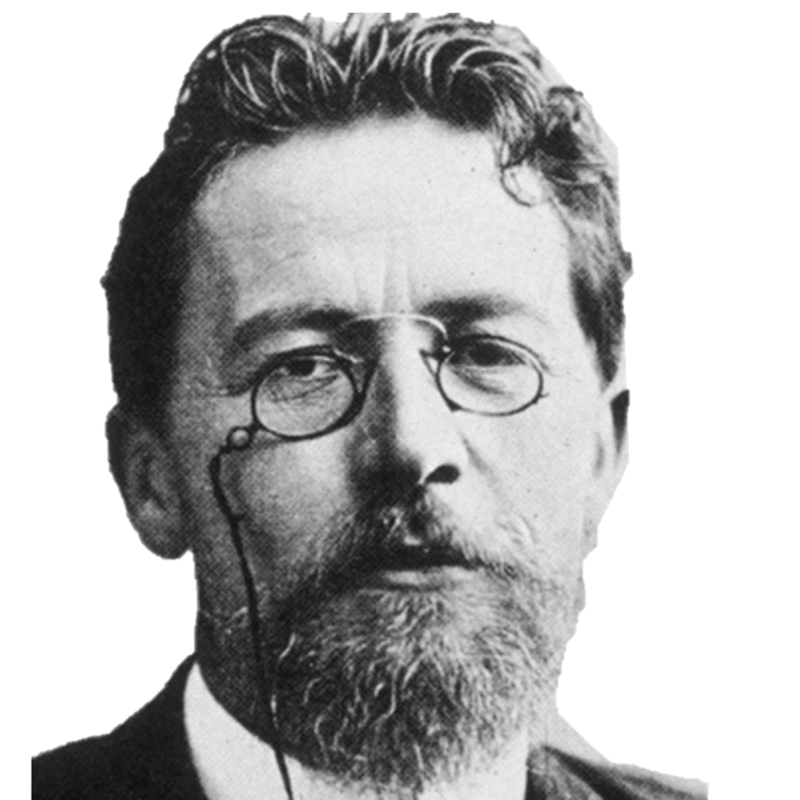
“Remove everything that has no relevance to the story. If you say in the first chapter that there is a rifle hanging on the wall, in the second or third chapter it absolutely must go off. If it's not going to be fired, it shouldn't be hanging there.” Anton Chekhov

Slide 33
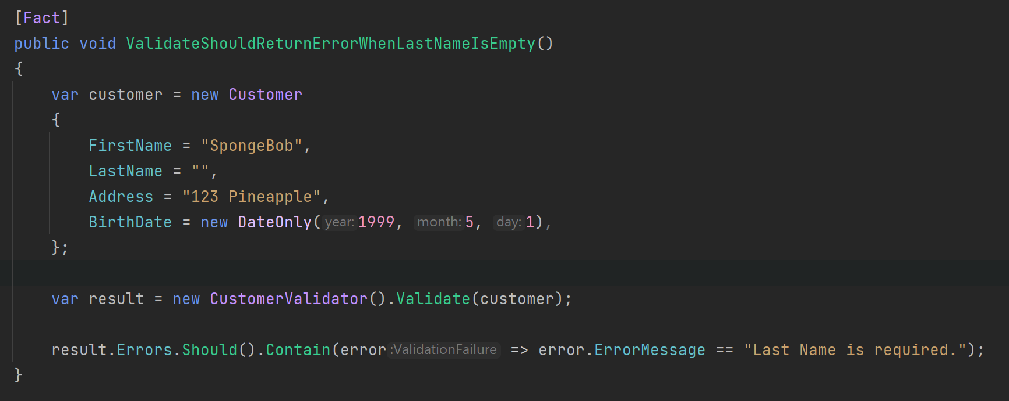
Chekhov’s Gun Applied to Testing
scottsauber

Slide 34
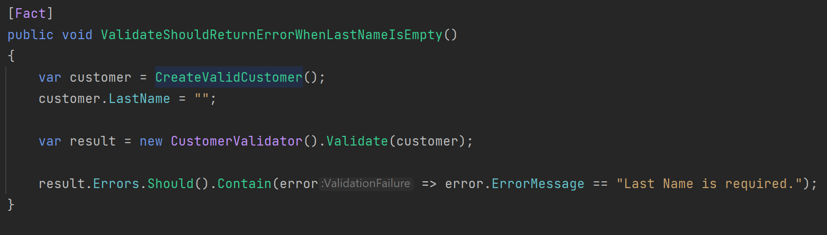
Chekhov’s Gun Applied to Testing
scottsauber

Slide 35
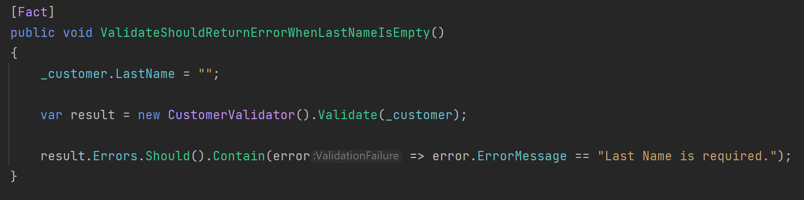
Chekhov’s Gun Applied to Testing
scottsauber

Slide 36
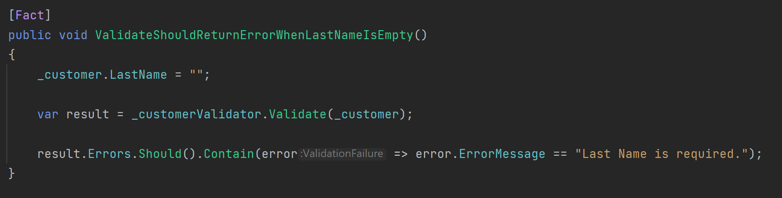
Chekhov’s Gun Applied to Testing
scottsauber

Slide 37
Chekhov’s Gun Applied to Testing
scottsauber

Slide 38
</ ChekhovsGun>

Slide 39
bunit.web.query
More ways to query the DOM that are less implementation specific
React Testing Library style
Queries promote A11y
More coming in next 6 months
scottsauber

Slide 40
Live Coding!

Slide 41
How can I get started with TDD?
When you get a bug report coming in
Write a failing test that proves the bug exists
Make it pass
scottsauber

Slide 42

But I don’t have time!

Slide 43

Why?
Notes:
Too understaffed
Too much support work fixing bugs

Slide 44

My boss won’t let me!

Slide 45

What about this person?
Notes:
What if you went to your surgeon and said “Hey I need this operation done” and he goes “Okay it’ll take 24 hours.” And if you respond “Okay but can you do it in 4?” …would you want to get surgery from the surgeon who agrees to that?
“Oh yeah I can totally do that surgery in 4 hours, I just need to not wash my hands, not wash the tools from the last surgery, and I’ll just use 5 stitches to sew you up instead of 50.”

Slide 46
You don’t get better at TDD by NOT doing TDD

Slide 47
Takeaways
Why you should TDD
How to test Blazor
What to test in Blazor
How to get started TDDing Blazor
scottsauber

Slide 48

Resources
TDD By Example by Kent Beck
Write Tests blog post by Kent C Dodds
https://github.com/scottsauber/talks
This slide deck
scottsauber

Slide 49
Questions? Email: ssauber@leantechniques.com
Slides up at scottsauber.com
scottsauber

Slide 50
Thanks!
Slides up at scottsauber.com
scottsauber

